Slide 1
Agile Cross-Pollination:
Growing Agile Adoption at
Farm Credit Mid-America

Slide 2
$19B agriculture lending cooperative
95,000 farmers, agribusinesses and rural residents in IN, OH, KY and TN
farm real estate financing, operating loans, equipment & livestock loans
Crop insurance and farm leasing
We help farmers
feed America!
About
Farm Credit
Mid-America

Slide 3
Agenda
Planting the Seeds of Agile Adoption
Cross-Pollination with Business Partners
The Harvest

Slide 4
Planting the Seeds of Agile Adoption

Slide 5
History of Adoption
2008
Began with one pilot project using a CSM
“By the Book”, focusing on technique
Functional managers for QAs, BAs and developers
2009
Trained all team mates in Scrum
Procured VersionOne tool
Director implemented “Story Points per Developer”
2010
More training
Work assigned, not volunteered by team mates
Story sizes start to grow (13, 20+)

Slide 6
History of Adoption (cont.)
2012
Hired CSC and CIO, each with 8+ years Agile experience
Teams of 4 developers, 1 BA, 1QA report to one leader
Eliminated “Points per Developer” metric
Started recording/resolving impediments
Implemented “coaching” culture
13 software releases

Slide 7
History of Adoption (cont.)
2013
Introduced Scrum/Kanban to other IT teams
Create the Leader Board
Changed from Individual bonus to Team bonus program
Changed from high walled cubes to low walled honeycomb
Performance reviews focus on communication, collaboration, team focus and innovation skills
26 software releases

Slide 8
What we learned
Functional managers → Team Leaders
Points per Developer promotes individualism
Smaller stories are better
Smaller and more frequent releases are better
Tracking impediments works!
Other IT teams followed suit

Slide 9
Examples of IT Work Boards
Infrastructure
Business Applications
Service Desk
Security
Intranet

Slide 10
The biggest value to the IT department was…
The business teams took notice of our success!
“Show us how you did it!”

Slide 11
Planting the Seeds of Agile Adoption
Cross-Pollination with Business Partners

Slide 12
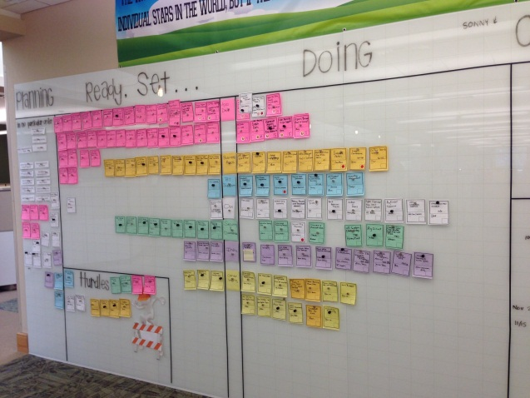
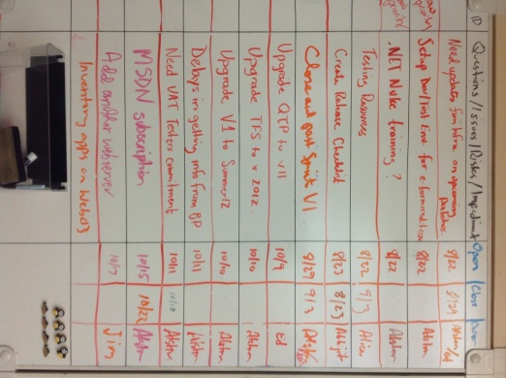
WHY it all started
Leader Board
Impediment Board reflected the bottle necks in development
Training material not ready in time
Business partners not available for Demos and UAT

Slide 13
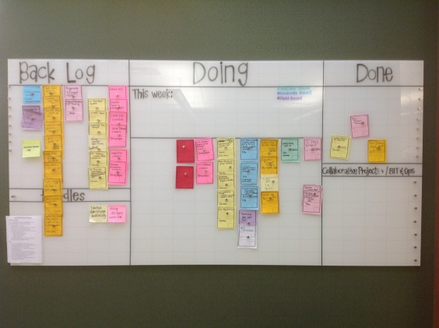
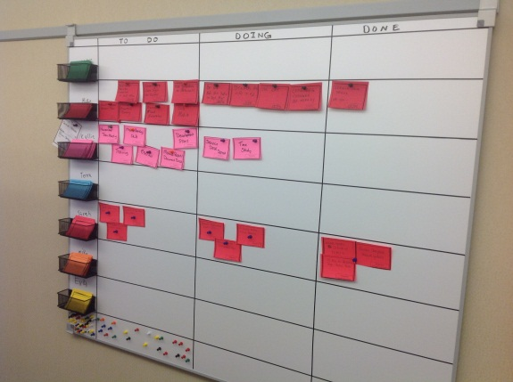
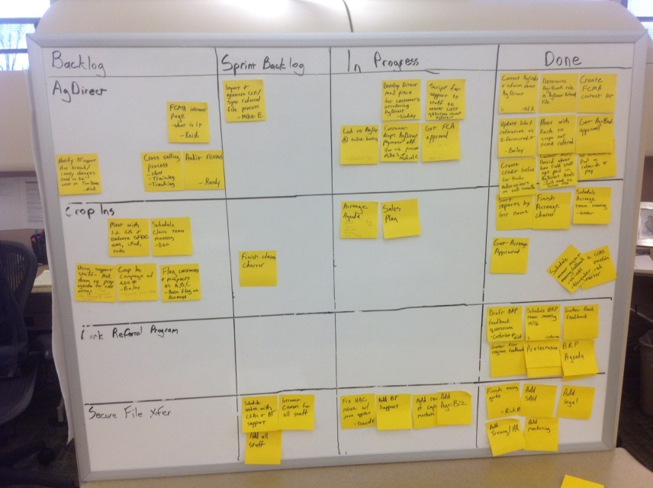
WHERE it all started
Training
Loan Accounting
Operations

Slide 14
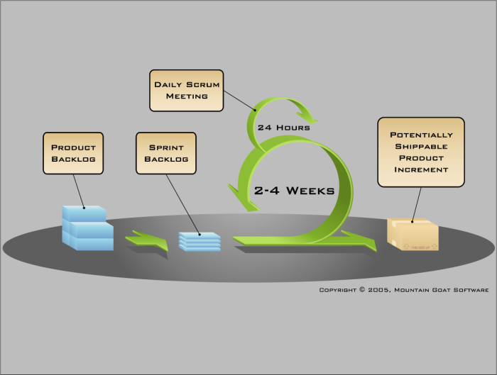



HOW it all started
Introduced Scrum & Kanban
The Myth of Multi-tasking
The Name Game

Slide 15
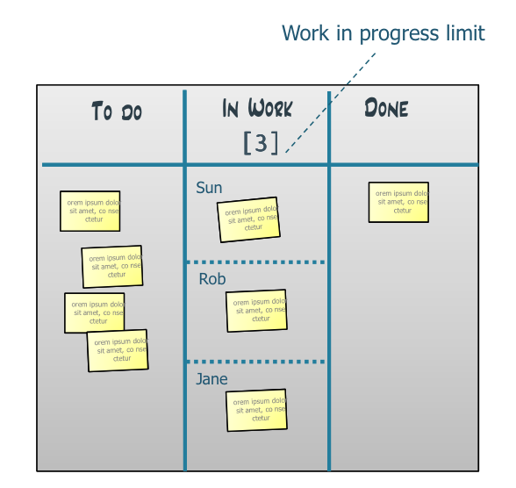
Two Simple Rules of Kanban… 1: Visualize your work 2: Limit work in progress

Slide 16
Start Simple
Let it evolve over time…

Slide 17
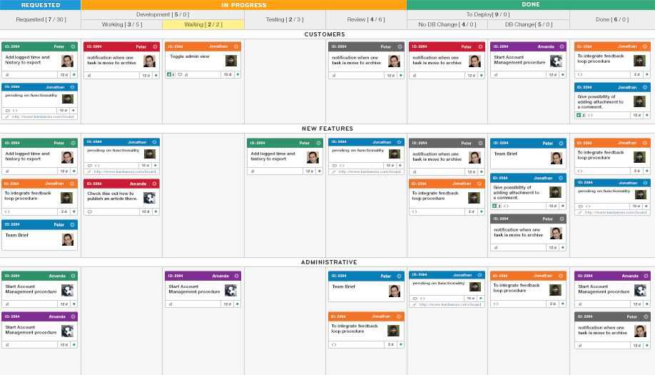

Slide 18

Myths of Multi-tasking
Task switching
Reduced productivity
Reduced quality

Slide 19
Want proof that it doesn’t work?
The Name Game

Slide 20
Planting the Seeds of Agile Adoption
Cross-Pollination with Business Partners
The Harvest

Slide 21
Benefits to business teams
Wow, look how much work is in play!
Are we working on the right things?
Some over-worked, some not.
Easy to rollup for weekly/monthly reports.
Do we still need weekly reports?
Powerful tool for coaching and developing others

Slide 22
Benefits to business team leaders
Wow, look how much work is in play!
More sense of accountability among team mates.
I need to help prioritize their work!
I need to help remove impediments!
I need to delegate more!
Maybe I don’t need a weekly report any more!
Maybe I don’t need a weekly staff meeting anymore!

Slide 23
Benefits to business leader of leaders
Wow, look how much work is in play ☺ ☹
I need to help prioritize their work!
I need to help remove impediments!
I need to delegate more!
I can quickly see evidence of progress.
I can see patterns in issues between boards.
I can forecast milestones easier now.
I don’t need to follow-up as much as before.
Maybe I don’t need a weekly report anymore!
Maybe I don’t need a weekly staff meeting anymore!

Slide 24
Benefits to Application Development
Business partners allocate time to UAT and demos.
Less re-work with business partners involved more.
Rewarding to know we are working on what’s most important to business.
Mutual respect and appreciation.
Managing business partners expectations easier.
Stronger partnership between business and AppDev.

Slide 25


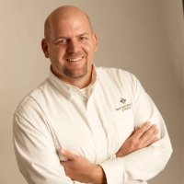
Comments from Leaders of leaders
“Biggest surprise was the revelation of how much work people were engaged in. This is powerful in helping me and my leaders prioritize the work that really needs to get done.”
“I love seeing team mates offering to help each other, when they see someone overwhelmed or falling behind. Camaraderie has improved.”
“What a powerful tool to help us stay focus on what really matters to the business. We can easily show how our work directly aligns to our business goals and objectives.”

Slide 26
Challenges in using Scrum/Kanban
Finding and staying within our WIP limits
Some on team still do not embrace this
Some see the number of cards as a competition
Some cards stay on board for a long time
But we are a team of specialists! Can it work for us?

Slide 27
Summary
Agile techniques are not just for Application Development.
Value in “speaking the same language”.
Helps keep the company (from top to bottom) focused.

Slide 28
Questions?

Slide 29
Contact info
Alston E. Hodge
502-631-3175
alston.hodge@e-farmcredit.com
blog: www.alstonhodge.com
Meetup: www.meetup.com/Louisville-Agile-Forum/

Slide 30
Sample Kanban Boards

Slide 31
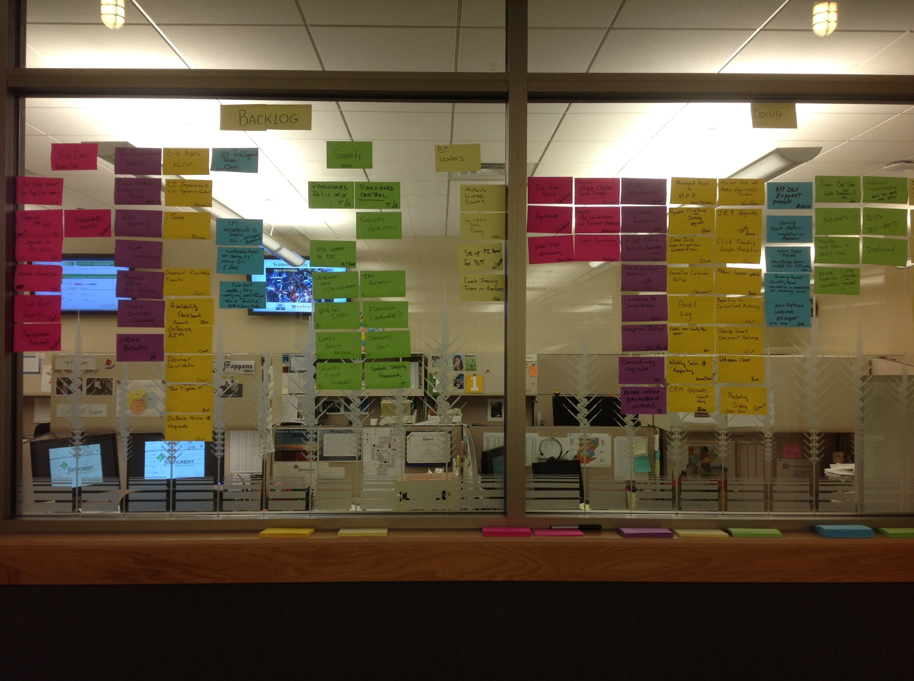

Slide 32


Slide 33
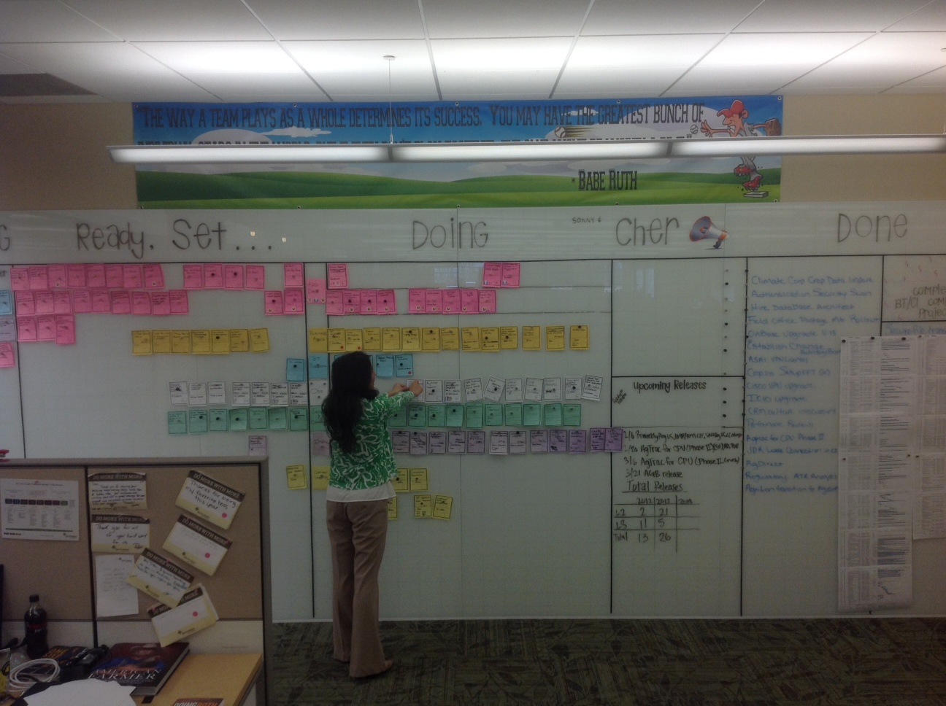

Slide 34
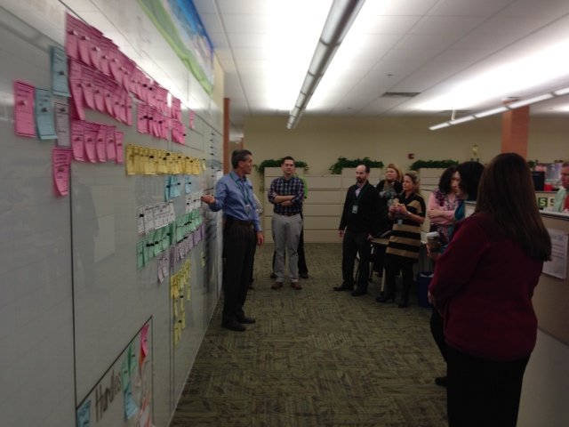

Slide 35


Slide 36


